Slide 1
Technical And Business Writing
A CASE STUDY IN EFFECTIVE TECHNICAL COMMUNICATION
MYSQL INSTALLATION GUIDE DOCUMENTATION PAGE
26 August, 2024

Slide 2
PURPOSE:
KEY FOCUS AREAS:
Design-Oriented
Audience-Focused
Ethical Communication
Rhetorical and Professional Standards
Demonstrating how the MySQL Installation Guide exemplifies effective technical communication.

Slide 3
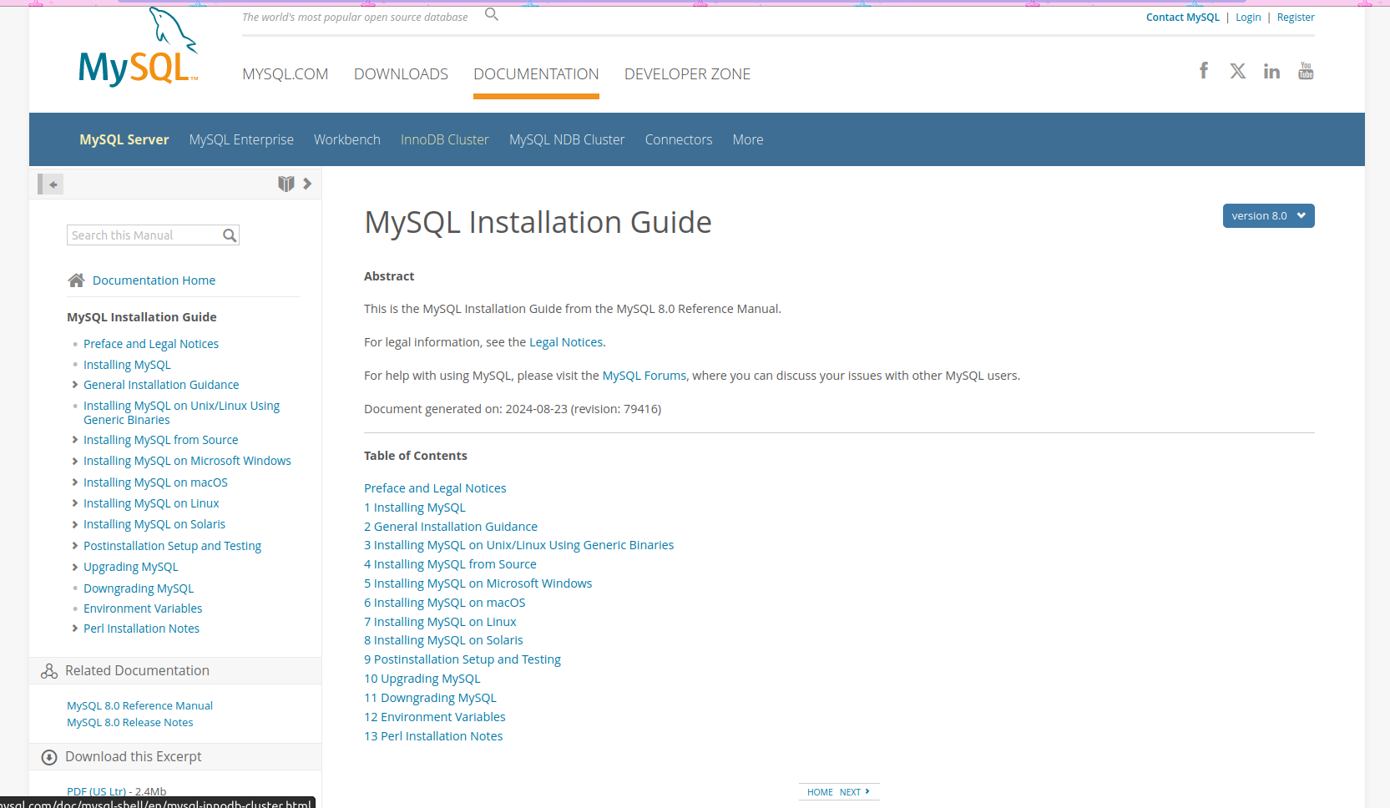

DESIGN-ORIENTED APPROACH
STRUCTURED LAYOUT:
Clear table of contents.
Segmented Information:
Chapters and sub-sections for easy navigation.
User Experience:
Visual clarity and ease of use.

Slide 4
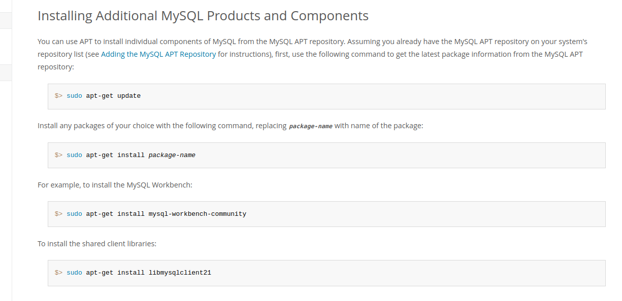
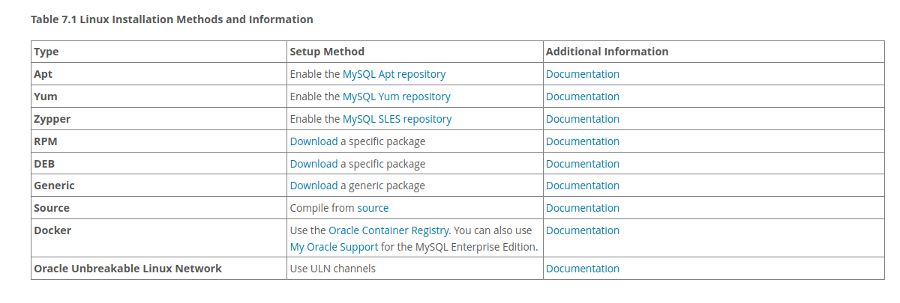
AUDIENCE-FOCUSED CONTENT
DIVERSE USER NEEDS:
Caters to both beginners and experts.
Multiple Installation Methods:
Customized for different operating systems.
Step-by-Step Instructions:
Amplifies complex tasks for all users.

Slide 5
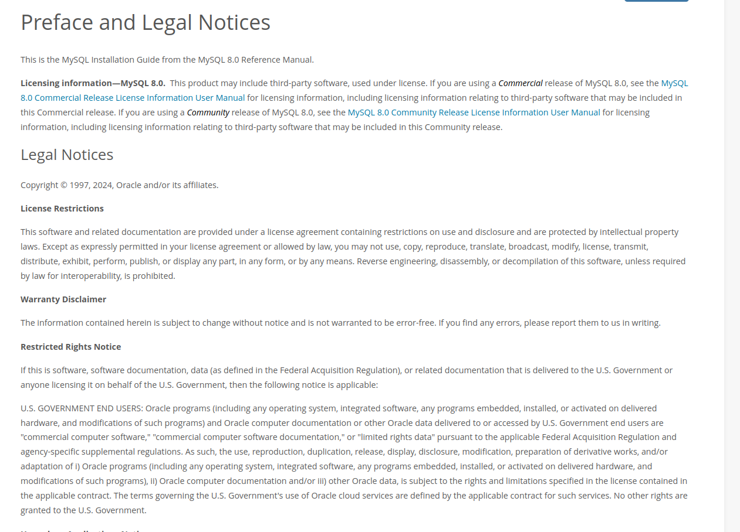
ETHICAL COMMUNICATION
TRANSPARENCY:
Clear legal notices and revision history.
Trustworthiness:
Accurate and reliable information.
Professional Integrity:
Adherence to legal and ethical standards.

Slide 6
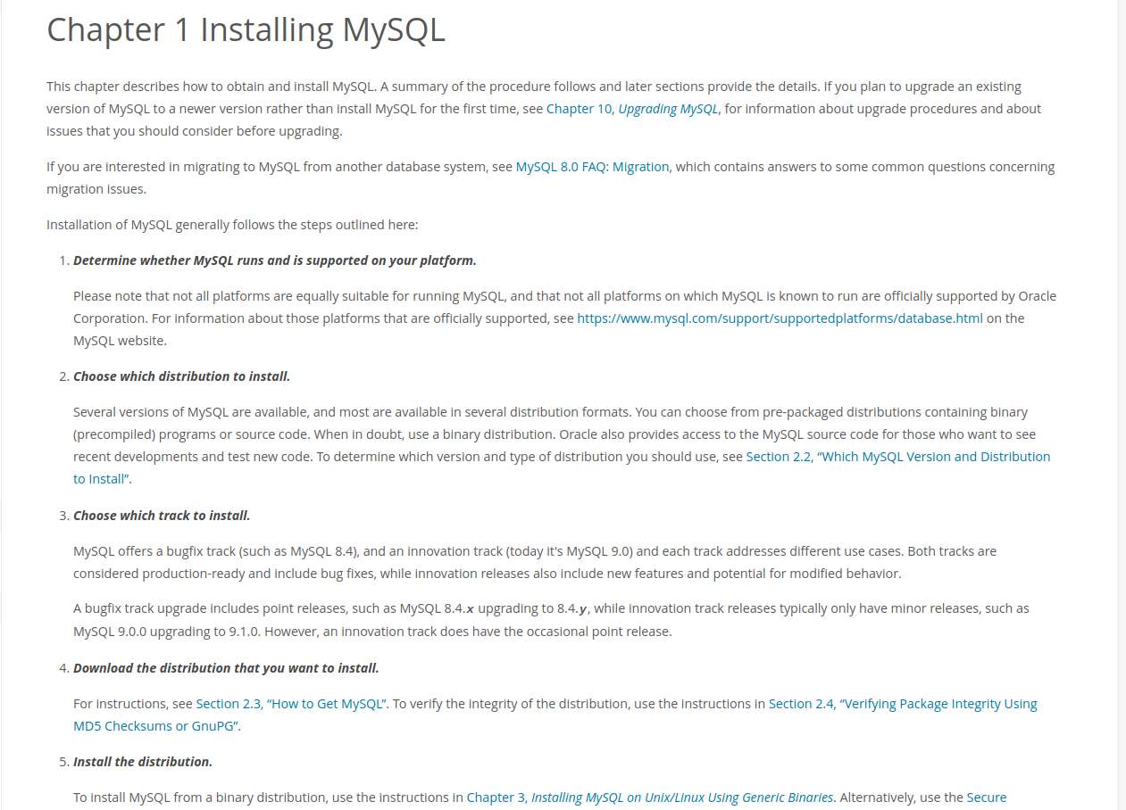
RHETORICAL & PROFESSIONAL STANDARDS
PLAIN LANGUAGE:
Reduces misinterpretation.
Consistent Terminology:
Ensures clarity.
Logical Organization:
Information flows smoothly.

Slide 7
CONCLUSION
Summary: MySQL Installation Guide as a model of effective technical communication.
Key Strengths: Design-oriented, audience-focused, ethically responsible, and professionally sound.
Final Thought: Whether for beginners or experts, the guide provides clear, accessible, and reliable information.

